Slide 1

Locka
Zhang Xi
Nyimas
Tiffany
Yu Xuan
Janessa

Slide 2






Zhang Xi
Scrum Master
Tiffany
Yu Xuan
Nyimas
Janessa
Development Team

Slide 3
Table Of Contents
Design Thinking
Pain Points + Resolution
Sprint
Conclusion
Demo

Slide 4
Design Thinking

Slide 5
Design Thinking
Background

Slide 6
Background
No space to store their study/school materials
Find it bothersome to carry materials in between classes
Most don’t know how to
rent a locker
Others find locker renting process is troublesome

Slide 7
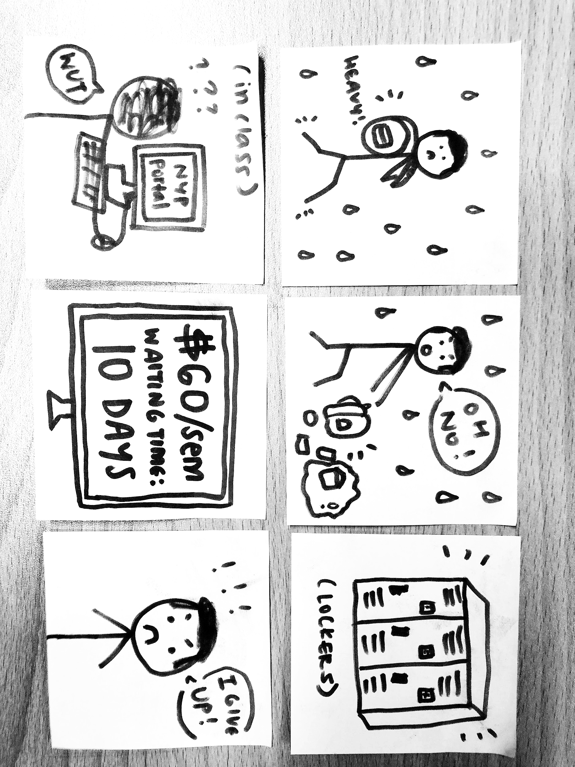
Problem Scenario
Before

Slide 8
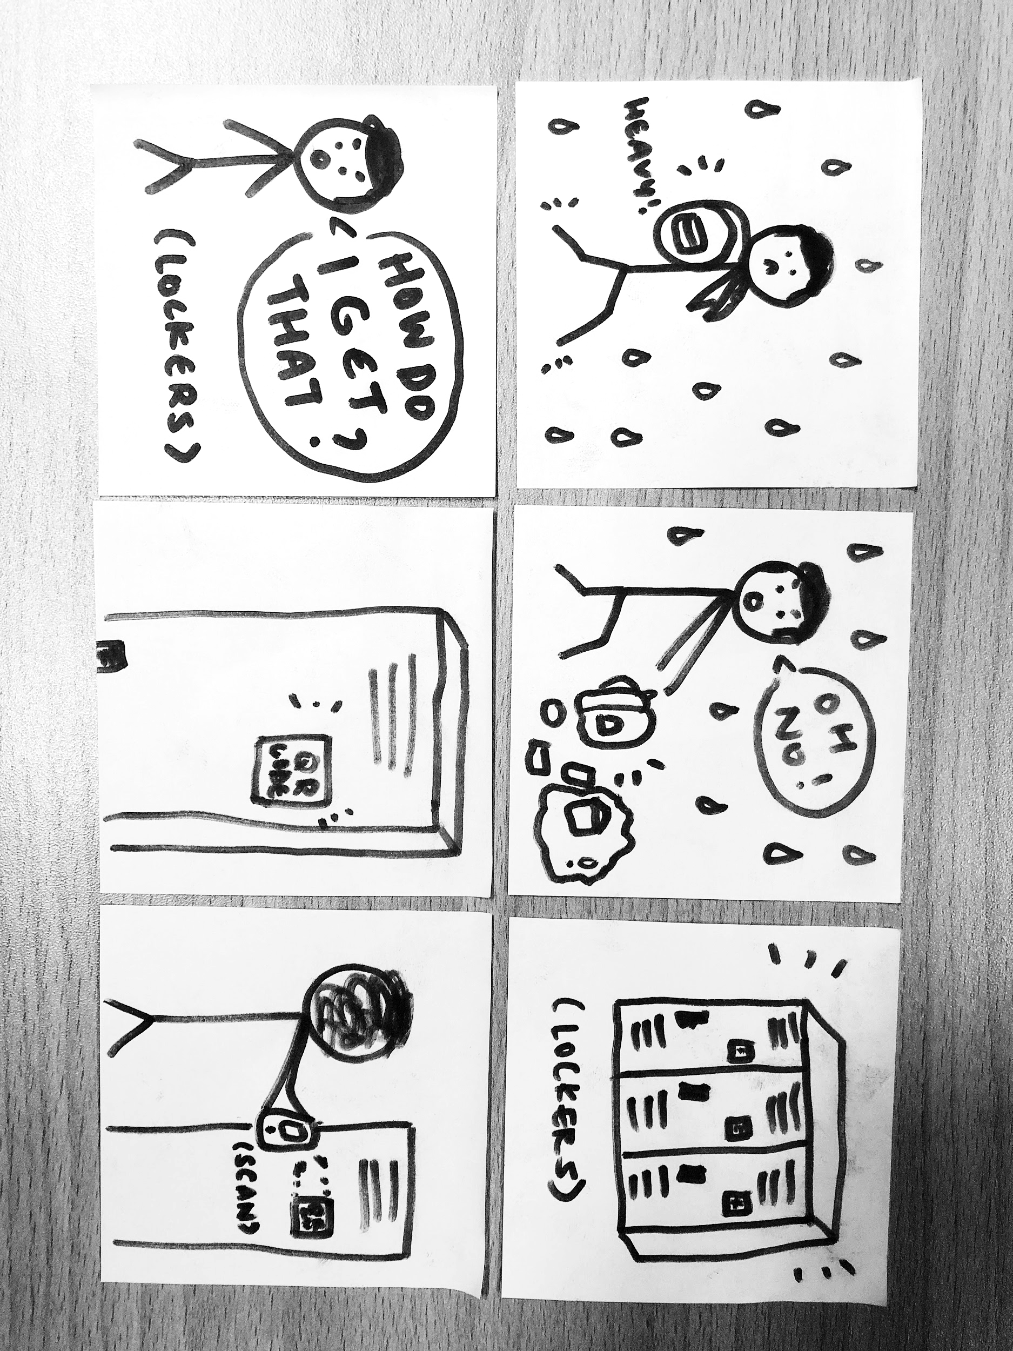
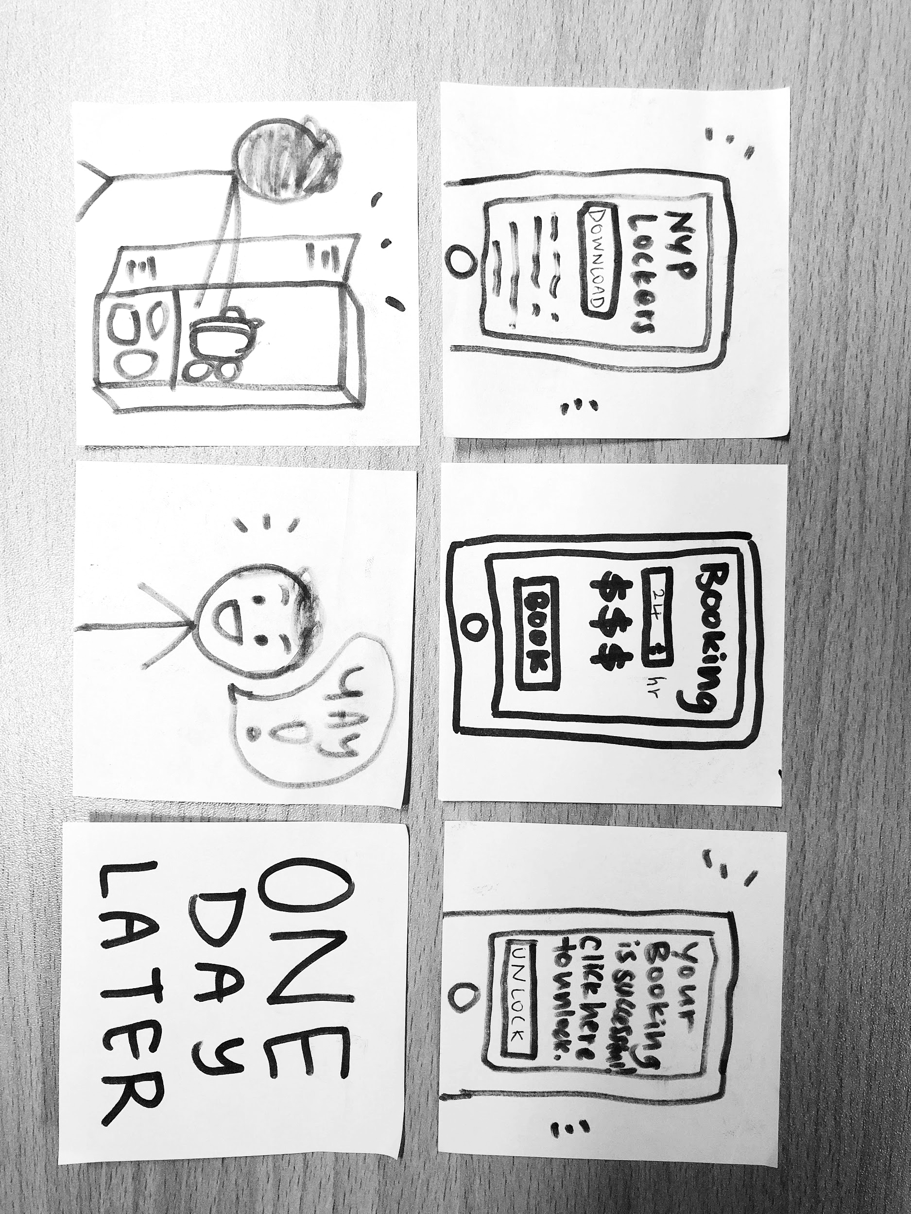
Problem Scenario
After

Slide 9
Design Thinking
Persona

Slide 10

Persona
Frustrations
Bright student
Sporty
Smart
Not punctual
Always struggling to carry studying materials such as boots & laptop
Need to bring his sports gear for after school activities
Stay far away from school
Does not have a space to keep his stuff
Goals
Do well for studies
Head to school without carrying several things
Daniel, 20
Lives In Pasir Ris
NYP SEG Y2

Slide 11
SAY
Empathy Map
THINK
“I didn’t know anything about the lockers”
“I think that the school should raise more awareness about the renting of lockers.”
“I want a place to keep my things in school.”
“I think that it is troublesome to rent lockers.”
Daniel
“I attend school 5 days per week”
“I feel frustrated having to bring several stuffs back and forth from school and home.”
“I bring my course materials, boots and laptop everyday.”
DO
FEEL

Slide 12
Design Thinking
Redefined Challenge Statement

Slide 13
Redefined Challenge Statement
How might we create a smart service which will allow students to enjoy a better locker rental experience so that it is more convenient and flexible?

Slide 14
Pain Points
+
Resolution

Slide 15
Pain Points
Must book the lockers for one whole semester
Don’t Know where the lockers are located at
Can’t see the overview of the availability of lockers

Slide 16
Pain Points + Resolution
Resolution

Slide 17
Locka

Slide 18
What Is Locka?
Locker rental system which allows users to book lockers as and when they need it.

Slide 19
Benefits Of Locka
Cost Efficient
Convenient
Easy To Use

Slide 20
Sprint
Overview

Slide 21
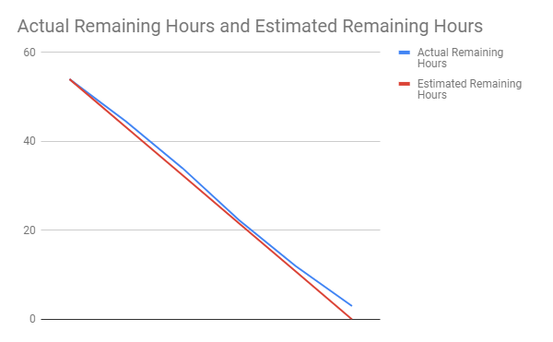
Sprint 1
Registration Page
Sign Up Page
Admin Page
Set Up Database

Slide 22
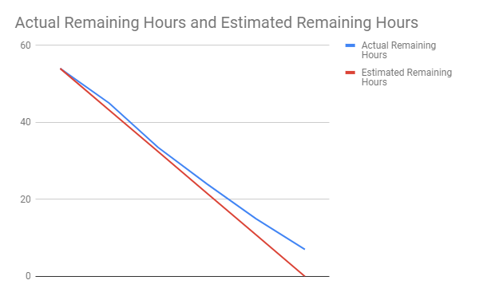
Sprint 2
Set Up eWallet
Availability of Lockers
Booking Transactions

Slide 23
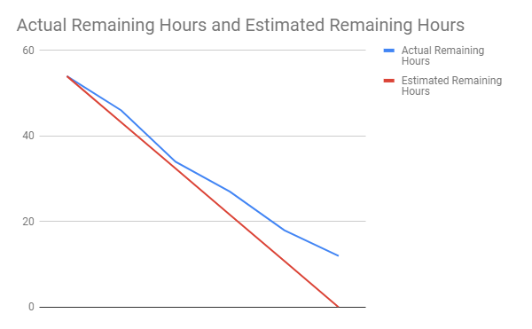
Sprint 3
Link eWallet webpage to payment of locker rental fees
Notifications Page
GPS location
Create simple locker icons using Maps JavaScript API
Using Geolocation API to locate users' locations and notify them where are the nearest lockers

Slide 24
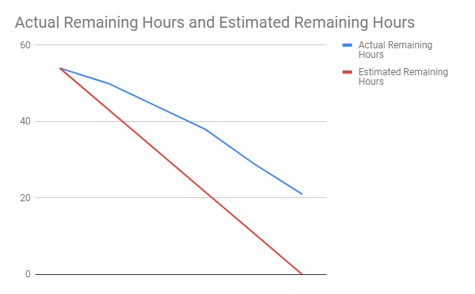
Sprint 4
Create page for user to set their new unlock pin verifying with the old pin
Create page for user to submit report of misuse for investigation
Create temporary access grant for another user to unlock locker

Slide 25
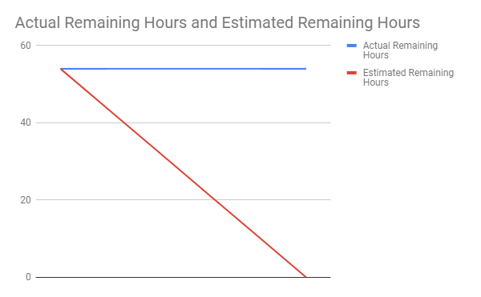
Sprint 5
Student Points
Shared Payment
Webpage to redeem points

Slide 26
Conclusion

Slide 27
Demo

